Slide 1
Institutional Context for IWRM and River Basin Planning in China
Clive Lyle
International IWRM Consultant

Slide 2
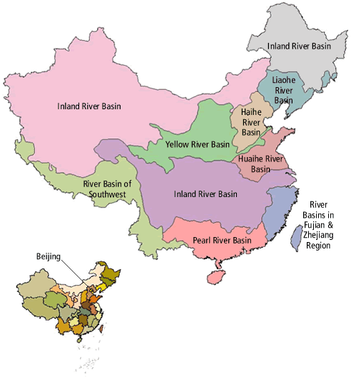
National Level River Basin Administration in China
For administrative purposes there are 7 National level River Basins :
Yellow River Basin (also responsible for inland basins)
Haihe Basin
Huaihe Basin
Songliao River Basin
Yangtze River Basin
Taihe Basin (lower Yangtse RB)
Pearl River Basin
The River Basin Commissions are units of the Ministry of Water Resources with their offices located within the respective river basin.
Songhua RB
Yangtze River Basin

Slide 3
The Yellow River Example
11 Provinces (States) in the Basin making it transboundary as Provinces have major water resource management responsibilities
Key water resource issues are water scarcity, flooding, sedimentation, pollution and environmental degradation
Zero flow occurred in the lower reaches in 21 years out of 27 years from 1972 to 1999 for a total no flow period of 1,091 days
Management of the river is shared between the YRCC and the Provinces
In essence, the YRCC establishes Provincial water allocations (both long term allocation scheme and then annual and emergency/drought plans) in consultation with Provinces
The allocation is approved by the State Council
Provinces then allocate water internally consistent with the overall scheme and their quota
Responsibilities for mainstream and tributary regulation mostly rest with the Provinces- some exceptions especially for larger reservoirs and flood control

Slide 4
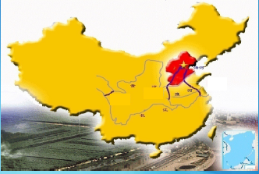
The Haihe Basin and Bohai Sea Example
Perhaps the most water scarce and polluted river basin in China
Some question as to whether it can really be rehabilitated (especially the pollution)
Surface water being transferred in from the Yangtze river basin (South to North Transfer)

Slide 5
The Haihe Basin and Bohai Sea Example

Slide 6
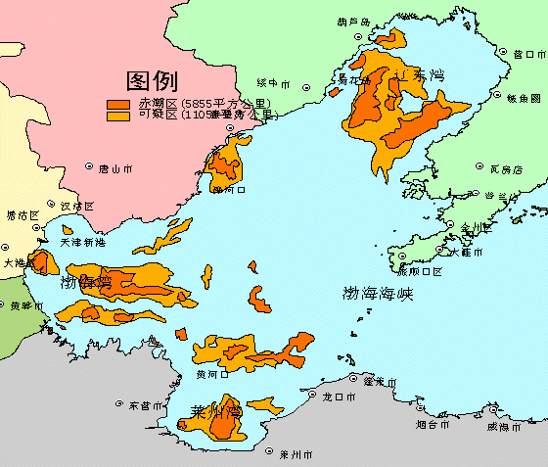
Serious Impacts on the Bohai Sea
Severe pollution from industry, urban growth and agriculture in Basin rivers
Along with the much reduced river flow into the rivers, the Bohai Sea is polluted causing red tides and depleting the fishery
1999-10

Slide 7
Hai Basin- Institutional Arrangements
7 Provincial level governments making it transboundary
Hai Basin Commission under the MWR mostly concerned with water sharing and conservation. Similar to YRCC
Ministry of Environment (since 2008) with the key role of pollution control
In order to manage the problems in a better way MWR and MEP have formed a Joint Program Steering Committee
MWR and MEP jointly plan basin management with some consultation with Provincial governments
Harmonisationisation of water management function zones and environmental standards
Implementation is by lower levels of government (Provinces, Municipalities, Counties)

Slide 8
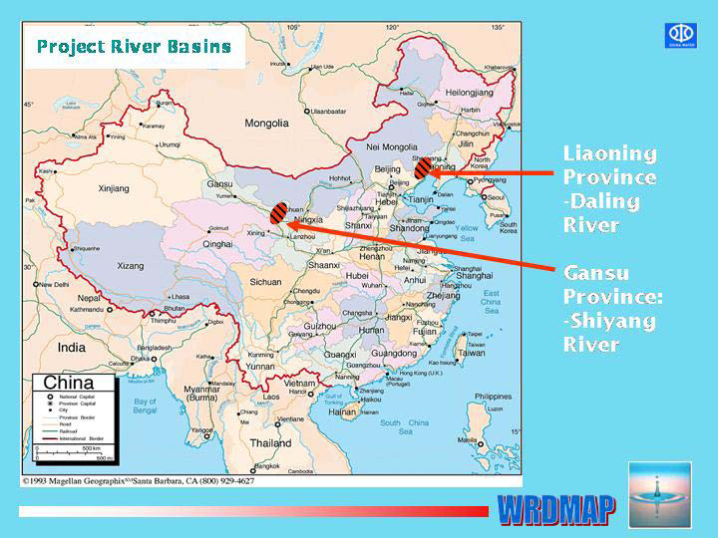
The Shiyang Basin Example
Situation
Inland river basin within one Province
Problems
Over use of water
River system and terminal lake system dry for many years,
deserts and sand storms expanding, extreme poverty and poor living conditions
Groundwater use unsustainable

Slide 9
The Shiyang RB Example
Formed RBO comprising Province and Municipality members
Comprehensive RB plan that involved:
Water allocation and permits
Strict Groundwater use control:
closure of groundwater wells (about 7,000 wells of 20,000 wells)
IC cards that control groundwater pump use and costs
Water saving practices: canal lining, irrigation practices, agronomy, cropping patterns, reducing canal lengths to reduce evaporation
Changed cropping patterns to increasing farmer incomes
Pollution control (via Environment Department)

Slide 10
Shiyang Basin Institutional Arrangements
Gansu Provincial Government
Shiyang River Basin Commission
Provincial Vice Governors (Vice-Ministers)
Directors of Gansu Departments
Municipality Vice Mayors (3)
Shiyang Basin Management Bureau
Wuwei Municipality
Jinchang Municipality
Zhangye Municipality
COUNTIES
VILLAGE WATER USER ASSOCIATIONS

Slide 11
Some concluding comments on the Chinese approach to River Basin management
Uncontrolled and rapid industrial and urban development can rapidly deplete the resource
Once this degradation has happened it is difficult and expensive to correct (especially the pollution)
Need for pre-emptive action
River basin units are recognised as the necessary unit for planning the sharing of water, the management of drought and part of the solution for pollution management

Slide 12
Some concluding comments (2)
There are 2 main models used (i) the more top down consultative model shown by the national level River Basin Commissions (ii) the newer cooperative, participative approach shown by the lower level RBOs
Both seem to work reasonably well. Is one better?
The RBO are effective compared to many in other countries probably because they have decision making powers and responsibilities. But mostly top down.
The nested approach (National-Province-County-WUA) to water resource management is effective and ensures Basin level planning connects to water users

Slide 13
Some concluding comments (3)
Responsibilities for policy and planning, and service provision such as river operations, and water supply to end users fairly clearly separated and accountable
Management of surface water and groundwater resources are in one agency enabling strong and integrated management
Chinese agencies have a very strong focus on action and the end results
They have managed to keep the approaches fairly simple, practical and to address the important issues

Slide 14
Some concluding comments (4)
Characteristic of Good IRBM | Progress
Water Laws | Recent, clear and comprehensive
Policies to control water sharing and pollution | Mostly good Enforcement variable Some water trading takes place with basic entitlements
Involvement of agencies in river basin management | Relevant agencies involved in more recent RBOs Difficult to achieve other agencies direct involvement (eg. environment, forestry) without prescriptive laws
River basin plans | Mostly effective and focussed on results Being funded and implemented Willing to make difficult decisions Innovative approaches being used
Data and information between agencies | Mostly reasonable data Limited sharing between agencies
Participation and engagement of water users | Generally limited although the administrative system enables bottom up feedback Users involved in implementation as needed
Financing of infrastructure O&M | Industry and urban tariffs collected Agriculture contributes water user fees for O&M

